Slide 1



Laboratory of Advanced Programming
Marco De Luca - 2017104
Angelo Casciani - 2022406
a.y. 2021/2022
Angelo Casciani - 2022406

Slide 2
Initial Idea
Web-app where content creators can publish videos to allow other users to watch them.
Functionalities:
Presents a landing page with the latest published videos;
Manage user authentication;
Presents a user profile page to update your credentials;
Allows the users to publish, search, watch, like and comment videos;
Allows the users to subscribe to their favourite content creators to easily access their videos.
Angelo Casciani - 2022406

Slide 3
User Stories
EPIC | USER STORY | PRIORITY | VALUE | RISK | ESTIMATE
SIGN-UP | As an unregistered user, I want to be able to register to the application so that I can access it | 1 High | 1 High | 1 High | 1
LOGIN | As a non-logged in registered user, I want to be able to login to the application so that I can use the application services | 1 High | 1 High | 1 High | 1
LOGOUT | As a registered user, I want to be able to logout from the application | 1 High | 1 High | 2 Med | 1
MAIN | As a registered user, I want to be able to view the Main Page, so that I can visualize the latest videos | 1 High | 1 High | 1 High | 5
SUBSCRIPTIONS | As a registered user, I want to be able to subscribe to a user, so that I can quickly access his videos/profile | 4 Low | 4 Low | 4 Low | 1
SUBSCRIPTIONS | As a registered user, I want to be able to reach the Subscriptions Page, so that I can visualize the channels I subscribed to | 2 Med | 2 Med | 3 Med | 1
SUBSCRIPTIONS | As a registered user, I want to be able to view the Subscriptions Page, so that I can visualize the channels I subscribed to | 2 Med | 2 Med | 3 Med | 3
SUBSCRIPTIONS | As a registered user, I want to be able to be notified when one of my subscriptions uploads a new video, so that I can easily know about it | 4 Low | 4 Low | 3 Med | 5
MY VIDEO | As a registered user, I want to be able to upload a video, so that others can see it | 1 High | 1 High | 2 Med | 2
MY VIDEO | As a registered user, I want to be able to view the videos I have uploaded on the platform | 1 High | 1 High | 1 High | 2
MY VIDEO | As a registered user, I want to be able to delete a video I previously uploaded so that others can't see it anymore | 1 High | 1 High | 1 High | 2
MY VIDEO | As a registered user, I want to be able to edit a video's details uploaded on the application | 2 Med | 2 Med | 4 Low | 2
VIDEO | As a registered user, I want to be able to watch a Video uploaded on the application | 1 High | 1 High | 1 High | 3
VIDEO | As a registered user, I want to be able to like/dislike/comment a video, so that I can interact with the content creator and his community | 3 Med | 3 Med | 3 Med | 2
SEARCH | As a registered user, I want to be able to search videos so that I can watch them | 1 High | 1 High | 1 High | 3
SEARCH | As a registered user, I want to be able to search other users, so that I can watch his profile and videos | 1 High | 1 High | 3 Med | 3
PROFILE | As a registered user, I want to be able to reach my Profile page so that I can see my details | 2 Med | 2 Med | 2 Med | 2
PROFILE | As a registered user, I want to be able to access another user's Profile page, so that I can see his details and his published videos | 3 Med | 3 Med | 2 Med | 2
PROFILE | As a registered user, I want to be able to manage my profile | 2 Med | 2 Med | 1 High | 2
PROFILE | As a registered user, I want to be able to delete my account and all videos uploaded | 2 Med | 2 Med | 1 High | 2
Angelo Casciani - 2022406

Slide 4
Effort Estimation
86 Function Points
4558 SLOC (estimated)
5921 SLOC (real)
4.7 Person/Month
5.9 Months
No. | Module | Function Name | Description | Type | DET | RET / FTR | Complexity | FP | Remarks
1 | User | User | Model stored to represent the users | ILF | 3 | 1 | Low | 7
2 | Video | Video | Model stored to represent the videos | ILF | 9 | 1 | Low | 7
3 | Comment | Comment | Model stored to represent the comments | ILF | 5 | 1 | Low | 7
4 | Notification | Notification | Model stored to represent the notifications | ILF | 2 | 1 | Low | 7
5 | Subscription | Subscription | Model stored to represent the subscriptions | ILF | 2 | 1 | Low | 7
6 | Login | Login | Login to the Application | EI | 2 | 1 | Low | 3
7 | Register | Register | Register to the Application | EI | 3 | 1 | Low | 3
8 | Main Page | Show Latest Videos | Shows the latest videos published on AMTube | EQ | 9 | 1 | Low | 3
9 | My Videos | Upload New Video | Upload a new video on AMTube | EI | 9 | 1 | Low | 3
10 | My Videos | Delete Video | Delete a video precedently uploaded | EI | 1 | 1 | Low | 3
11 | My Videos | Edit Video | Edit title/description/thumbnail of a video precedently uploaded | EI | 8 | 1 | Low | 3
12 | Profile | Edit Profile | Edit the user's username/mail/password | EI | 2 | 1 | Low | 3
13 | Notification | Show Notifications | Shows the user the latest videos uploaded by the users he subscribed to | EQ | 5 | 2 | Low | 3 | 3 DET from Video (Title, Date & Thumbnail)
14 | Subscription | Add Subscription | User subscribes to another user | EI | 2 | 1 | Low | 3
15 | Subscription | Delete Subscription | User cancels the subscription to another user | EI | 2 | 1 | Low | 3
16 | Video | Show Video | User views the selected video and its comments | EQ | 14 | 2 | Average | 4
17 | Video | Add Comment | User comments the video he's watching | EI | 5 | 1 | Low | 3
18 | Video | Delete Comment | User deletes his comment previously posted under the video he's watching | EI | 1 | 1 | Low | 3
19 | Video | Add Like/Dislike | User likes or dislikes the video he's watching | EI | 2 | 1 | Low | 3 | ID video + the number of likes/dislikes
20 | Profile | Show User | Show the profile of user | EQ | 6 | 3 | Average | 4 | Subscription + Username + Videos
21 | Search | Search | User queries for a video title or another user | EQ | 9 | 2 | Average | 4 | Videos + User
Angelo Casciani - 2022406

Slide 5
Work Analytics
5 Sprints
60 Total Days
227 Estimated Hours
3.78 Avg Estimated Hours per day
256 Total Hours
4,27 Avg Hours per day
TASK TITLE | TASK OWNER | AMOUNT OF WORK IN HOURS
 |  | ESTIMATE | COMPLETED | REMAINING
Project Definition |  | 23 | 25 | -2
Ideas Brainstorming | Everyone | 4 | 4 | 0
Research of Information | Everyone | 5 | 5 | 0
Project Planning | Everyone | 8 | 10 | -2
Scope, System Objectives & Goals Definition | Everyone | 2 | 2 | 0
Technical Architecture Sketching | Everyone | 2 | 2 | 0
Project Proposal | Everyone | 2 | 2 | 0
Project Setup |  | 20 | 20 | 0
User Stories | Everyone | 4 | 4 | 0
Wireframes | Everyone | 6 | 6 | 0
Function Points & COCOMO Estimation | Everyone | 4 | 4 | 0
Product Backlog | Everyone | 4 | 4 | 0
Documentation | Everyone | 2 | 2 | 0
Back-End Implementation |  | 56 | 65 | -9
First version of the User Management Microservice | Casciani | 4 | 6 | -2
DB for User Management Microservice | Casciani | 1 | 1 | 0
User Management Functionalities | Casciani | 8 | 8 | 0
First version of the Notification Microservice | Casciani | 4 | 4 | 0
Subscription Model, Repository & Controller | Casciani | 6 | 6 | 0
Notification Model, Repository & Controller | Casciani | 6 | 6 | 0
First Version of the Video Microservice | De Luca | 6 | 8 | -2
DB for videos | De Luca | 1 | 1 | 0
Video, Comment and Like Models & Repositories | De Luca | 8 | 8 | 0
Controller for the Video Service | De Luca | 10 | 14 | -4
First Version of the Search Microservice | De Luca | 2 | 3 | -1
Front-End & API Gateway |  | 104 | 118 | -14
Start Frontend Microservice (model-components-structure) | Casciani | 4 | 4 | 0
Defined URLs | Casciani | 2 | 2 | 0
Fix Video Management | Casciani | 3 | 3 | 0
ApiGateway Redirect | Casciani | 4 | 4 | 0
Video Uploading from Frontend | Casciani | 4 | 8 | -4
Api Gateway Zuul | Casciani | 4 | 4 | 0
Video Visualization | Casciani | 4 | 4 | 0
S3 Support | Casciani | 4 | 4 | 0
JWT Authentication users Backend | Casciani | 4 | 4 | 0
Api Gateway Filtering | Casciani | 4 | 7 | -3
RabbitMQ Communication video & notification MS | Casciani | 5 | 6 | -1
Dockerfiles first version + Subscriptions Logic | Casciani | 4 | 4 | 0
Footer and Header | De Luca | 2 | 2 | 0
Login and Sign Up Pages | De Luca | 4 | 3 | 1
Home Page | De Luca | 6 | 7 | -1
My Videos Page & Upload new Video frontend logic | De Luca | 10 | 12 | -2
My profile Page | De Luca | 4 | 6 | -2
Video Details Page | De Luca | 6 | 8 | -2
Profile Page | De Luca | 6 | 6 | 0
Search Page | De Luca | 4 | 4 | 0
Edit-Video Page | De Luca | 4 | 4 | 0
Subscription Page | De Luca | 6 | 8 | -2
Notification Page | De Luca | 6 | 4 | 2
Containerization and Frontend Fixes |  | 24 | 28 | -4
ElasticSearch Support | Casciani | 8 | 10 | -2
Frontend fixes to home page and search page | De Luca | 6 | 6 | 0
Setup Docker | Casciani | 10 | 12 | -2
Angelo Casciani - 2022406

Slide 6
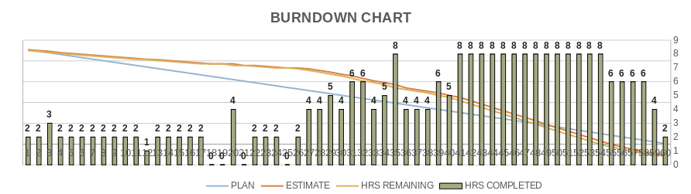
Angelo Casciani - 2022406

Slide 7
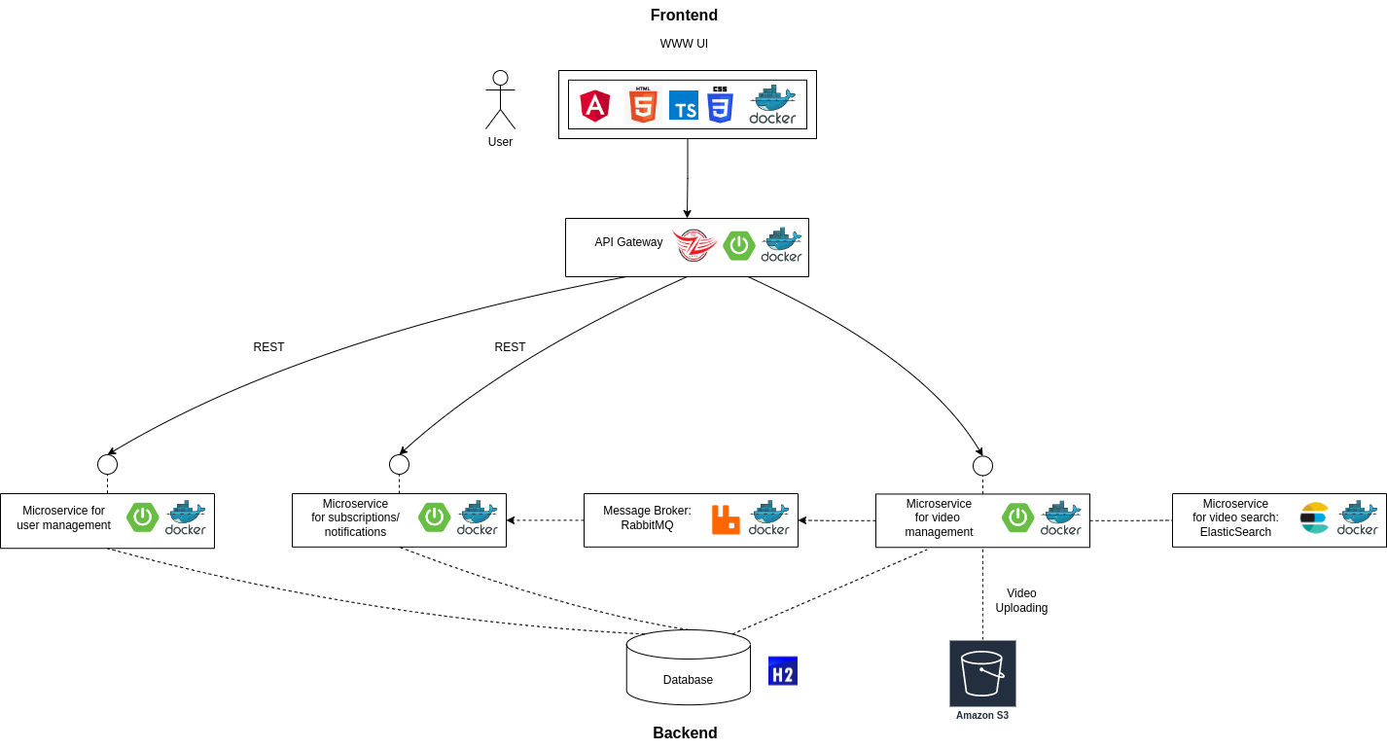
System Architecture
Angelo Casciani - 2022406

Slide 8




Frontend
Responsible for the UI, dealing with the visualization and interaction with the user.
Angelo Casciani - 2022406

Slide 9


Api Gateway
Based on Netflix Zuul.
Single entry point for the client.
Routes the user requests to the proper micro-service.
Contacts the User Management microservice to verify if the request is coming from an authorized user.
Angelo Casciani - 2022406

Slide 10
User Management Microservice
Handles registration / authentication (relying on a JWT token) /access to the user profile.
Angelo Casciani - 2022406

Slide 11



Video Management Microservice
Handles the CRUD operations related to videos.
Also allows the user to like/comment a video.
Videos are uploaded to an external Amazon S3 Bucket.
Uses RabbitMQ to communicate with the Notification/Subscription microservice.
Relies on another microservice based on ElasticSearch to perform search queries on the videos.
Angelo Casciani - 2022406

Slide 12
Subscriptions/Notifications Microservice
Deals with the subscriptions issued by each user.
Allows the user to be notified whenever one of his subscription uploads a new video.
Receives the communication of the upload from a queue handled by RabbitMQ.
Angelo Casciani - 2022406

Slide 13
We will now show a short demo of our application
Angelo Casciani - 2022406

